Slide 1

UNIT 1; All about me
Managing time

Slide 2
Do you wake up early in the morning when you go to school?
Have you got enough time to make your bed, have breakfast and do everything you are supposed to before school?
Do you always do all your homework/housework in a day?
Is there anything you could do better?

Slide 3
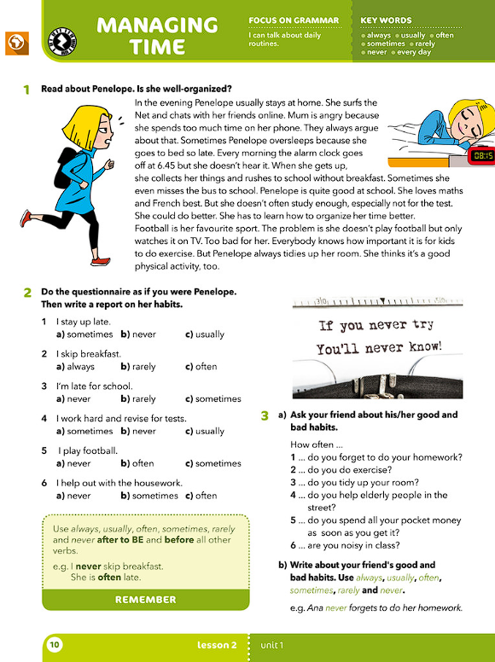
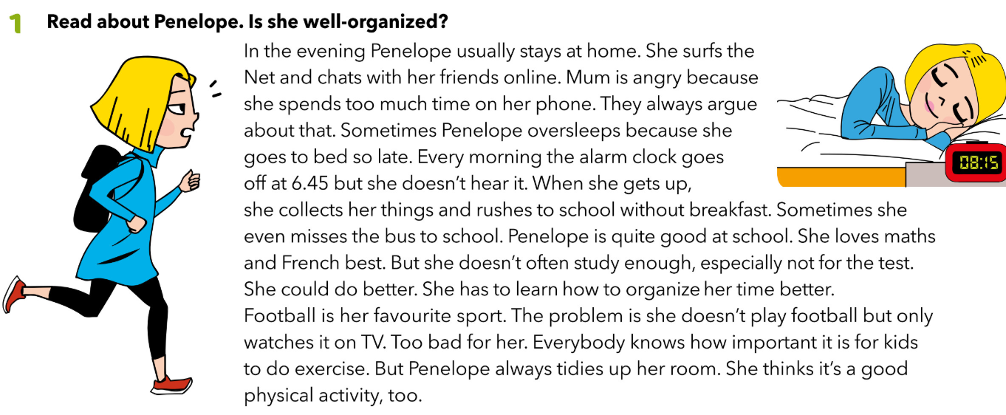
Read about Penelope. Is she well organized?

Slide 4
Which Penelope’s habbits help her do things on time/ be responsible?
What does she do wrong?
Which habbits do you and Penelope have in common?
What do you do better?
argue svađati se
oversleep prespavati
rush požuriti
important važno

Slide 5
Adverbs of frequency (prilozi učestalosti) odgovaraju na pitanje How often? / Koliko često se nešto događa?
always uvijek, stalno
every day svaki dan
usually obično, redovito
often često
sometimes ponekad
rarely rijetko
never nikada
Prilozi su nepromjenjiva vrsta riječi koje se dodaju najčešće glagolima za označavanje mjesta, vremena, načina, uzroka, učestalosti radnje.
Prilozi učestalosti govore koliko se često neka radnja odvija.

Slide 6
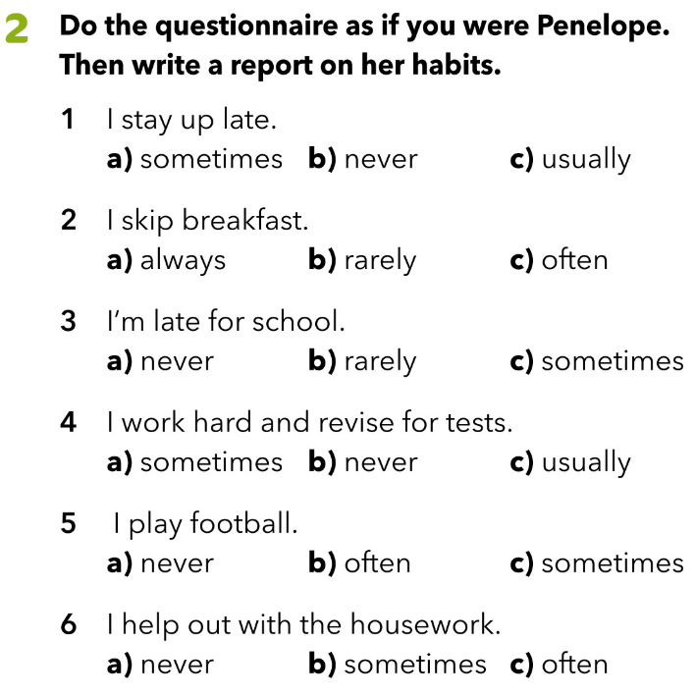

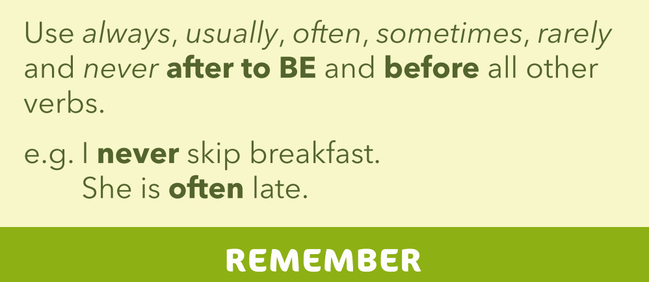
Priloge učestalosti u rečenici uvijek stavljamo iza glagola biti, a ispred svih ostalih glagola.

Slide 7
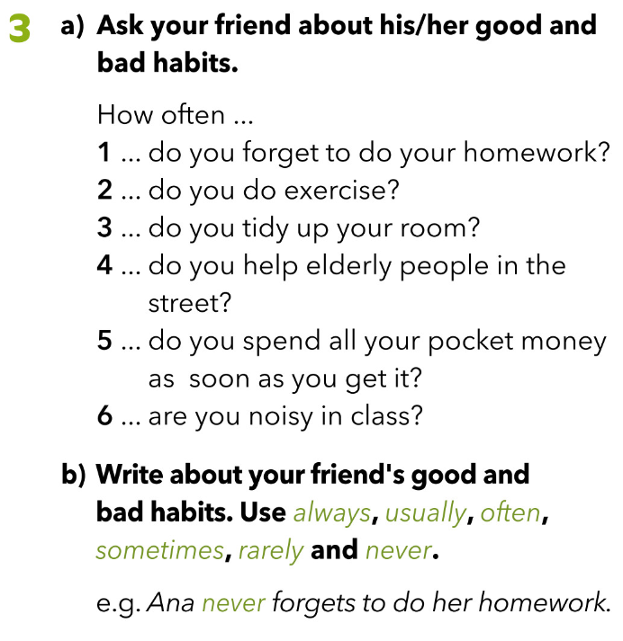
Send a text or call your friend and ask him/her about his/her good and bad habits. Write.

Slide 8
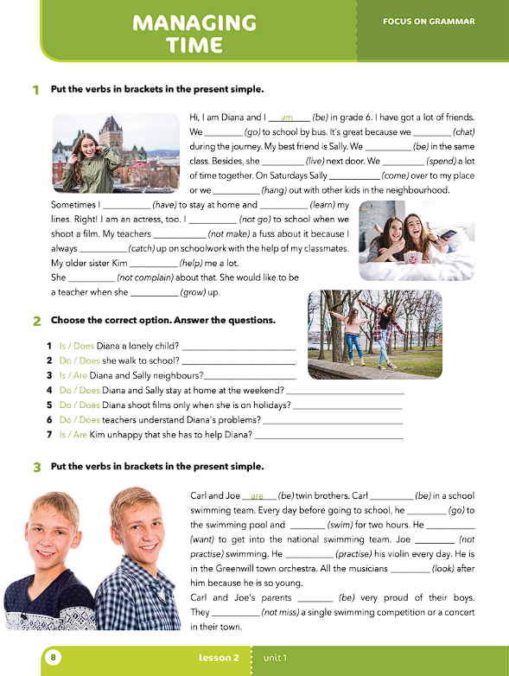
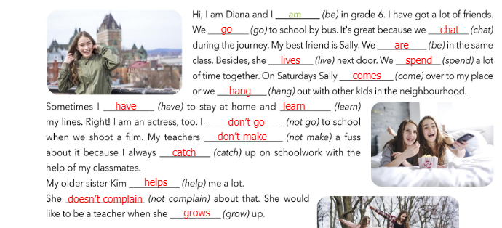
Put the verbs in brackets in the present simple.
VIDEO -PRESENT SIMPLE : https://youtu.be/ni3JB0hrxyw

Slide 9
What do you remember about Penelope?
How often does Penelope stay at home in the evening?
What happens when she goes to bed late?
Does she always get the bus to school?
Does she study enough?
Complete the text:
https://wordwall.net/play/538/378/555

Slide 10
I sometimes stay up late.
Penelope sometimes stays up late.
I often skip breakfast.
She often skips breakfast.
- glagolu u 3. licu jednine dodajemo
nastavak –s ili -es

Slide 11
Present Simple negative
I don’t stay up late. I don’t skip breakfast.
She doesn’t stay up late. She doesn’t skip breakfast.
Present Simple Questions
-
Do you stay up late? Do you skip breakfast?
Does she stay up late? Does she skip breakfast?

Slide 12
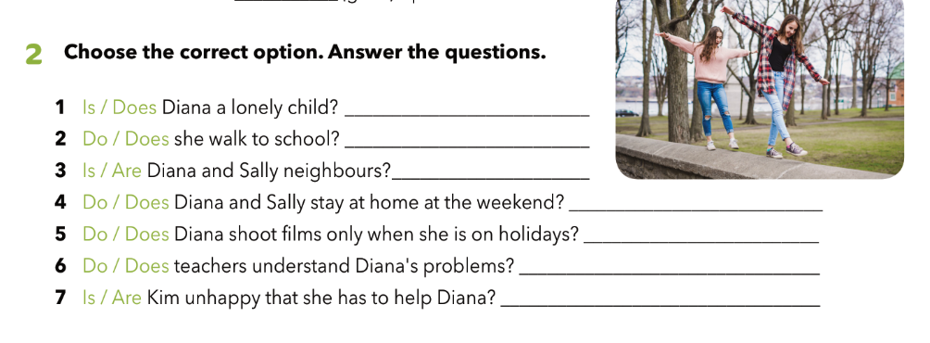
In task 2, choose the correct option. Answer the questions.
No, she isn’t.
No, she doesn’t.
Yes, they are.
Yes, they do.
No, she doesn’t
Yes, they do.
No, she isn’’t.
Ask your friend:
Are you a lonely child?
Do you walk to school?

Slide 13
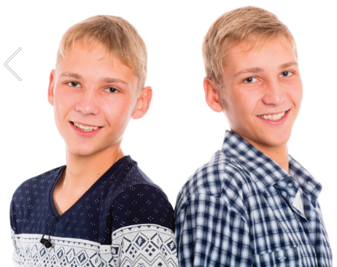
Look at the photo.
The boys are Carl and Joe.
What do you think their relationship is?
Do they play any sport?
Do they play an instrument?
How often do they practice?
Are their parents happy about their activities?

Slide 14
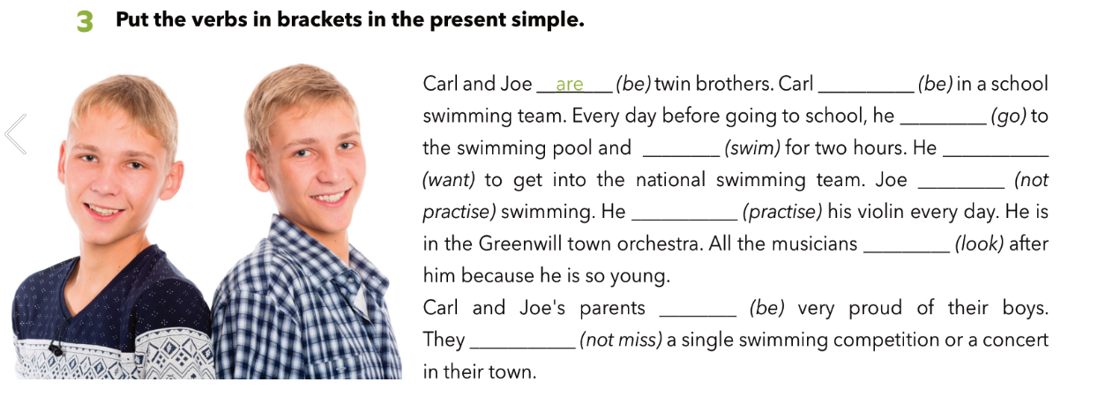
is
goes
swims
wants
doesn’t practise
practises
look
are
don’t miss

Slide 15
